Slide 1
SENG 1000 - Software Engineering Foundations and Practice (using Python)
-Sumati

Slide 2
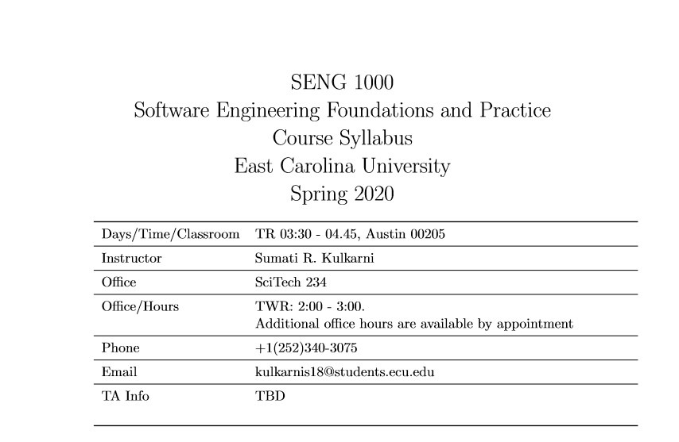
Syllabus

Slide 3
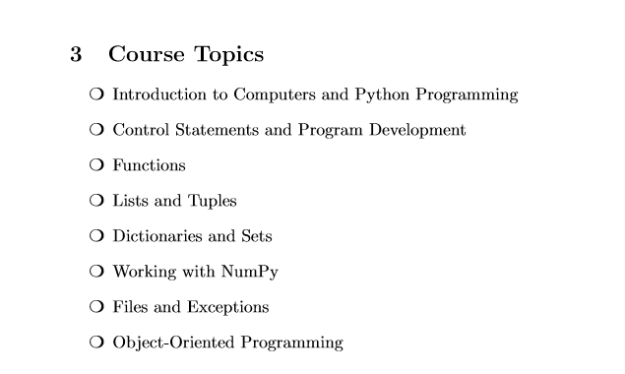
Syllabus

Slide 4
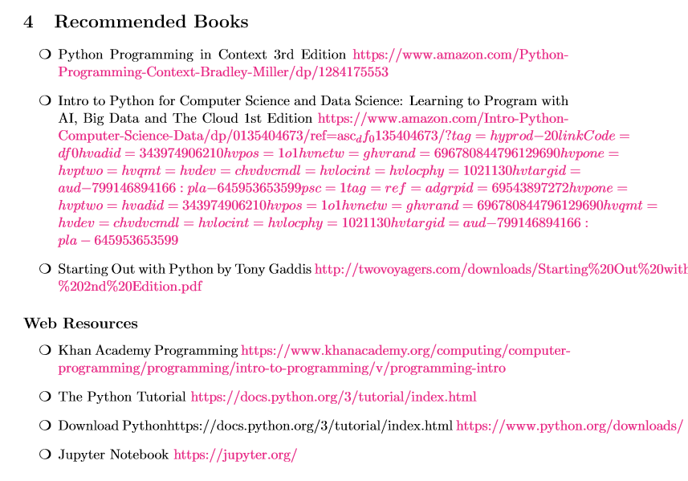
Syllabus

Slide 5
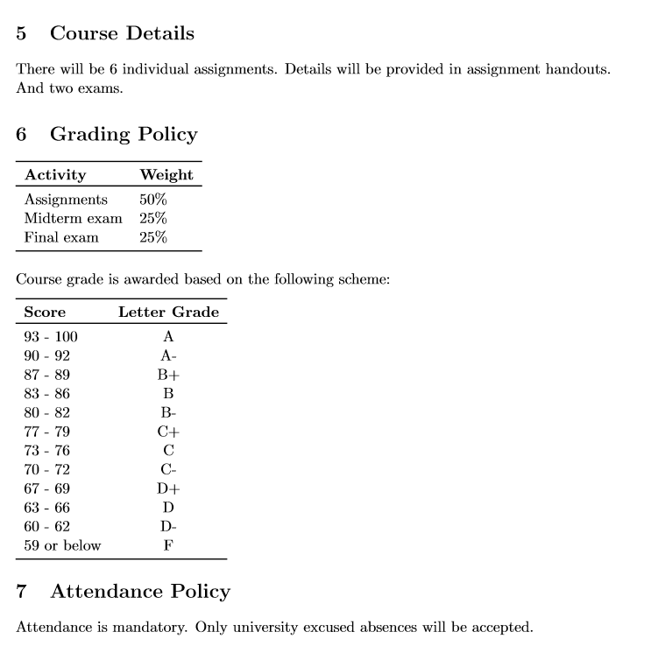
Syllabus

Slide 6
Topics
Introduction to programming
History of Computers

Slide 7
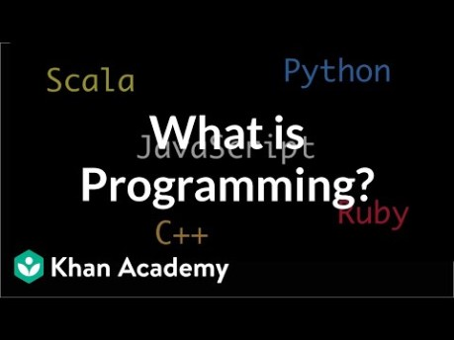

Slide 8
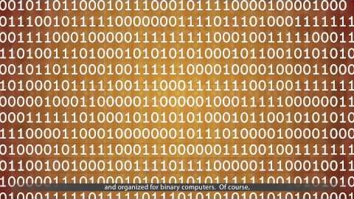

Slide 9
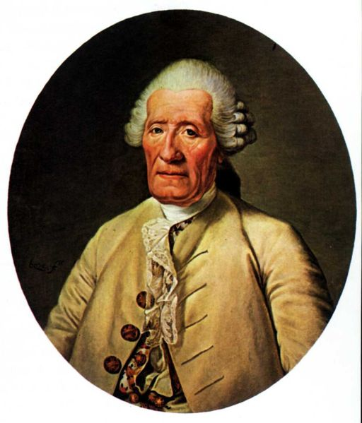
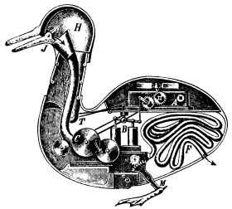
Jacques de Vaucanson 1709-1782
Gifted French artist and inventor
Son of a glove-maker, aspired to be a clock-maker
1727-1743 – Created a series of mechanical automations that simulated life.
Best remembered is the “Digesting Duck”, which had over 400 parts.
Also worked to automate looms, creating the first automated loom in 1745.

Slide 10
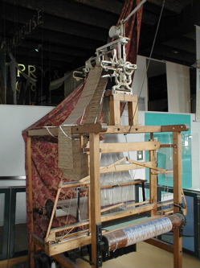
1805 - Jacquard Loom
Invented by Joseph Jacquard
First fully automated and programmable Loom
Used punch cards to “program” the pattern to be woven into cloth

Slide 11
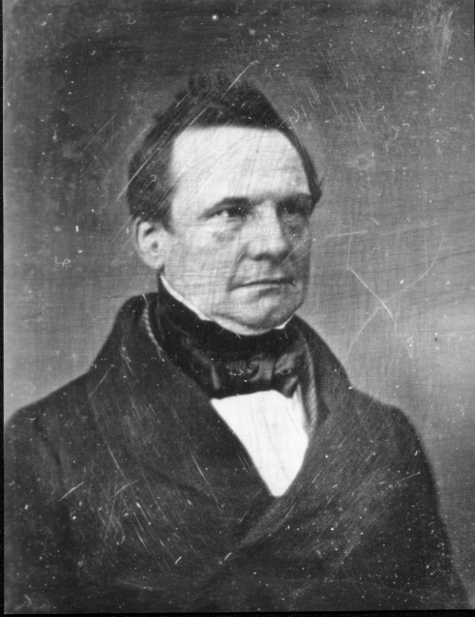
Charles Babbage 1791-1871
English mathematician, engineer, philosopher and inventor.
Originated the concept of the programmable computer, and designed one.

Slide 12
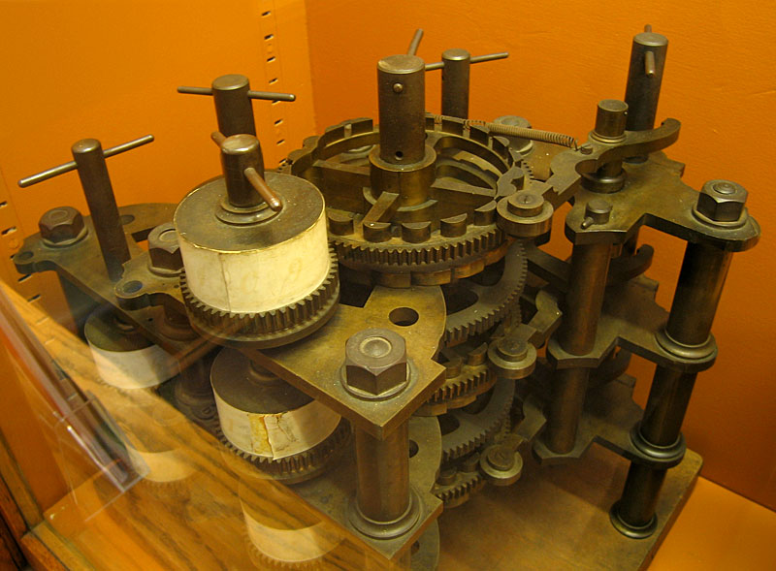
1822 – Difference Engine
Numerical tables were constructed by hand using large numbers of human “computers” (one who computes).
Annoyed by the many human errors this produced, Charles Babbage designed a “difference engine” that could calculate values of polynomial functions.
It was never completed, although much work was done and money spent.
Working Video:
https://www.youtube.com/watch?v=0anIyVGeWOI
Book Recommendation:
The Difference Engine: Charles Babbage and the Quest to Build the First Computer -by Doron Swade

Slide 13
1837 – Analytical Engine
Charles Babbage first described a general purpose analytical engine in 1837, but worked on the design until his death in 1871. It was never built.
As designed, it would have been programmed using punch-cards and would have included features such as sequential control, loops, conditionals and branching. If constructed, it would have been the first “computer” as we think of them today.

Slide 14
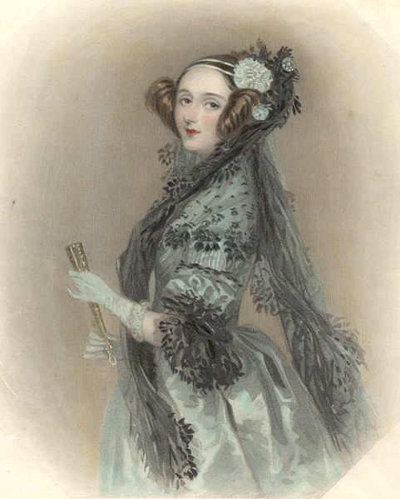
Augusta Ada Byron King, Countess of Lovelace 1815-1852
The Right Honourable Augusta Ada, Countess of Lovelace
Created a program for the (theoretical) Babbage analytical engine which would have calculated Bernoulli numbers.
Widely recognized as the first programmer.

Slide 15
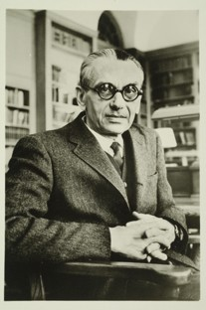
Kurt Gödel 1906-1978
Famous for his incompleteness theorem
This theorem implies that not all mathematical questions are computable (can be solved).

Slide 16
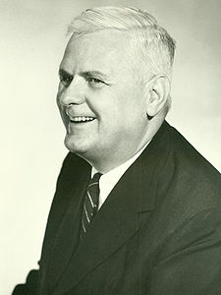
Alonzo Church 1903-1995
American mathematician and logician.
Developed lambda calculus, directly implemented by LISP and other functional programming languages.
Showed the existence of an undecidable problem.
Lambda calculus was proven to be equivalent to a Turning Machine by Church and Turing working together.

Slide 17
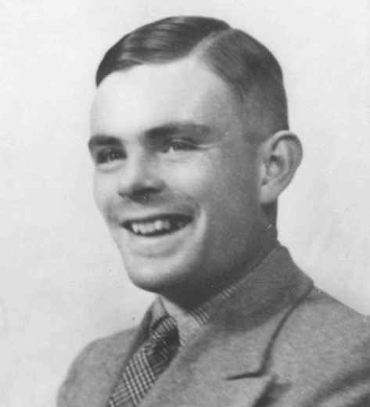
Alan Turing 1912-1954
British mathematician and cryptographer.
Father of theoretical computer science.
Contributions include:
Turing Machine
Turing Test (for AI)‏
First detailed design of a stored program computer (never built)‏
The Turing Machine is a simpler version of Kurt Gödel's formal languages.
Halting problem is undecidable.

Slide 18
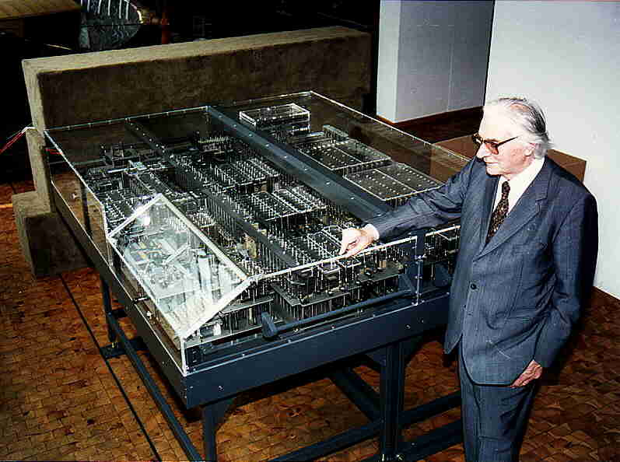
1936 – Konrad Zuse – Z1 Computer
First freely programmable computer, electro-mechanical punch tape control.

Slide 19
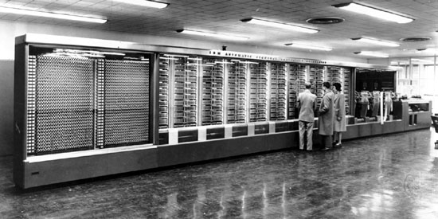
1944 – Howard Aiken & Grace Hopper – Harvard Mark I Computer
The IBM Automatic Sequence Controlled Calculator (ASCC) Computer was created by IBM for Harvard University, which called it the Mark I. First universal calculator.

Slide 20
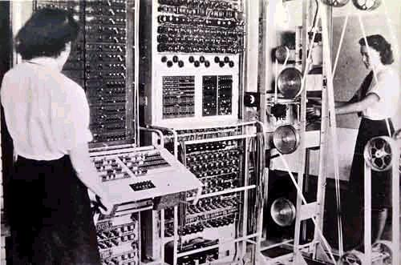
1943/1944 – Colossus Mark I & II
The Colossus Mark I & II are widely acknowledged as the first programmable electric computers, and were used at Bletchley Park to decode German codes encrypted by the Lorenz SZ40/42.

Slide 21

1946 –John Eckert & John W. Mauchly – ENIAC 1 Computer
ENIAC was short for Electronic Numerical Integrator And Computer. It was the first general purpose (programmable to solve any problem) electric computer. It contained over 17,000 vacuum tubes, weighed 27 tones and drew 150 kW of power to operate.

Slide 22
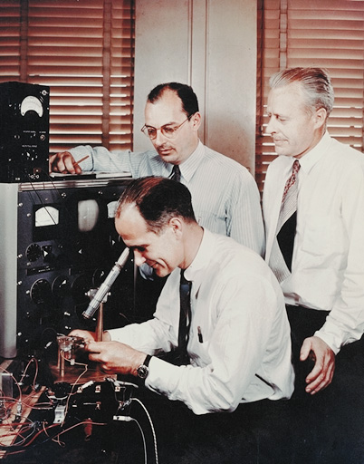
1947 –The transistor
Invented by William Shockley (seated) John Bardeen & Walter Brattain at Bell Labs. The transistor replaces bulky vacuum tubes with a smaller, more reliable, and power saving solid sate circuit.

Slide 23
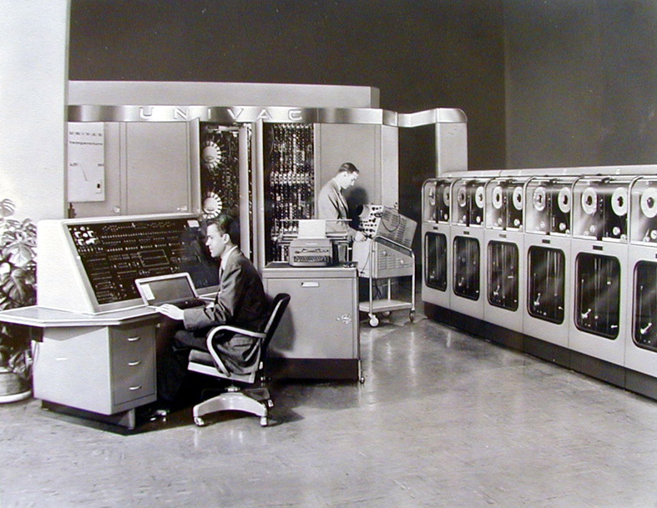
1951 – UNIVAC
25 feet by 50 feet in size
5,600 tubes,
18,000 crystal diodes
300 relays
Internal storage capacity of 1,008 fifteen bit words was achieved using 126 mercury delay lines
First commercial computer - Between 1951 and 1958, 47 UNIVAC I computers were delivered.

Slide 24
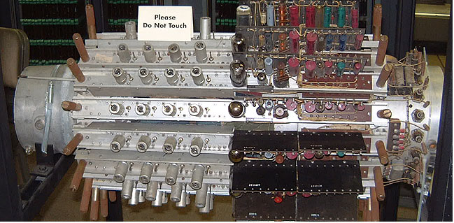
1951 – UNIVAC Mercury delay unit (1 of 7)‏
UNIVAC mercury delay units containing 18 delay lines, each of which stored 120 bits. Total of 2,160 bits, or 144 fifteen bit words per memory unit.

Slide 25
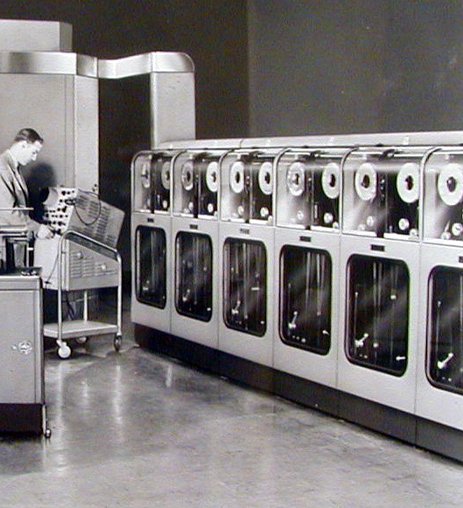
1951 – UNIVAC
UNIVAC tape units.

Slide 26
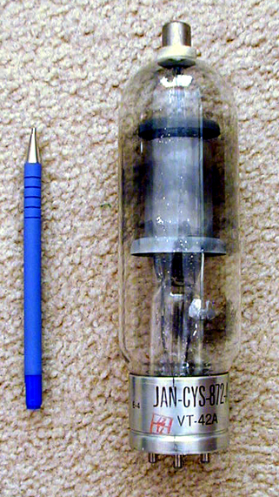
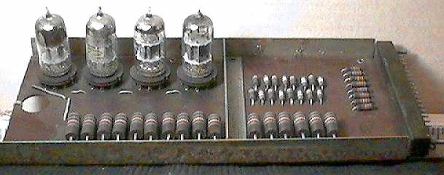
1951 – UNIVAC
UNIVAC tube board and individual vacuum tube.

Slide 27
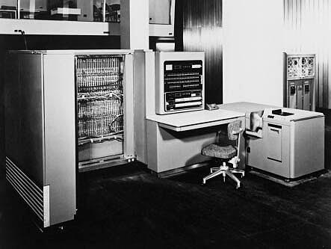
1953 – IBM 701 EDPM Computer
IBM enters the market with its first large scale electronic computer.
It was designed to be incomparable with IBM's existing punch card processing system, so that it would not cut into IBM's existing profit sources.

Slide 28
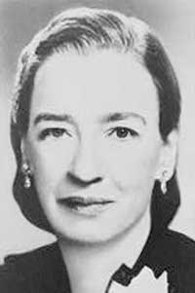
Grace Hopper 1906-1992
Developed the first compiler (A-0, later ARITH-MATIC, MATH-MATIC and FLOW-MATIC) while working at the Remington Rand corporation on the UNIVAC I.
Later returned to the NAVY where she worked on COBOL and was eventually promoted to Rear Admiral.

Slide 29
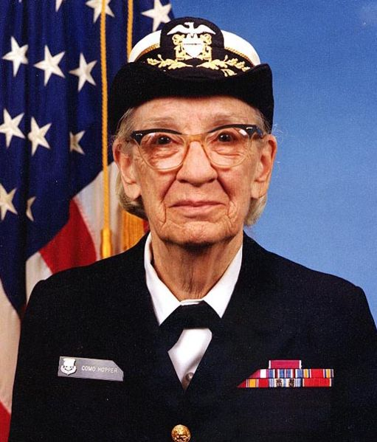
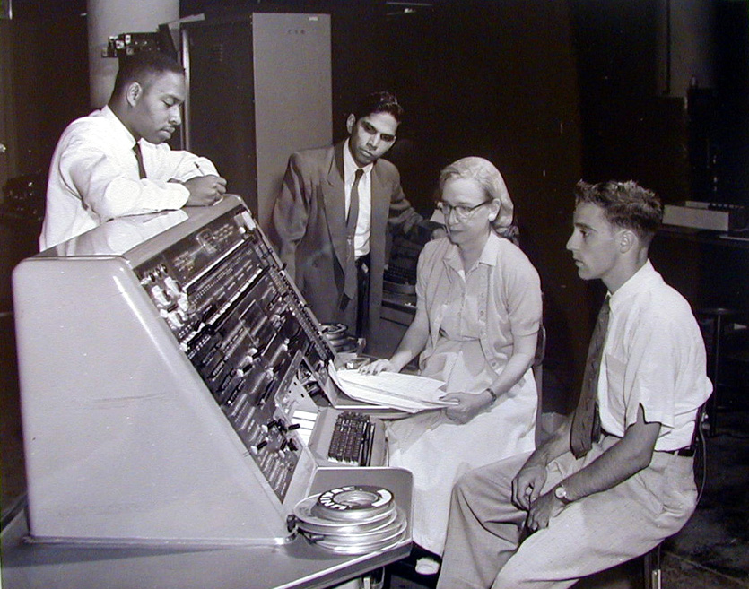
Grace Hopper 1906-1992
Rear Admiral Grace Hopper, US Navy, and other programmers at a UNIVAC console - 1957
Grace Hopper (January 1984)‏

Slide 30
Some of Grace Hopper's Awards
She won the first "man of the year" award from the Data Processing Management Association in 1969.
She became the first person from the United States and the first woman of any nationality to be made a Distinguished Fellow of the British Computer Society in 1973.
Upon her retirement she received the Defense Distinguished Service Medal in 1986
She received the National Medal of Technology in 1991

Slide 31
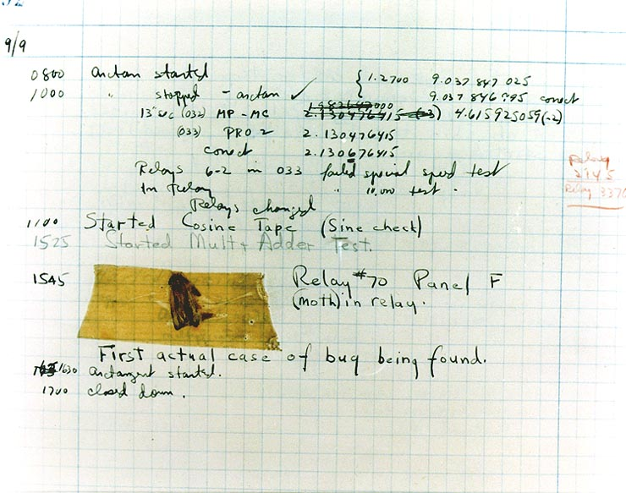

Slide 32
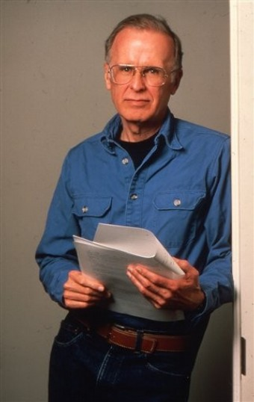
1954 – FORTRAN
John Backus & IBM invent the first successful high level programming language, and compiler, that ran on IBM 701 computers.
FORmula TRANslation was designed to make calculating the answers to scientific and math problems easier.

Slide 33
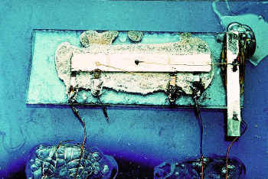
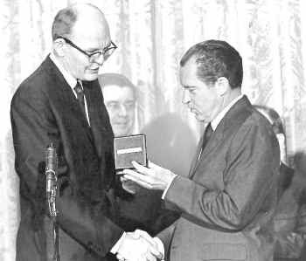
1958 – Integrated Circuit
Jack Kilby at Texas Instruments & Robert Noyce at Fairchild semiconductor independently invent the first integrated circuits or “the chip”.
Jack Kilby was awarded the National Medal of Science and was inducted into the National Inventors Hall of Fame, and received the 2000 Nobel Prize in Physics for his work on the integrated circuit.

Slide 34
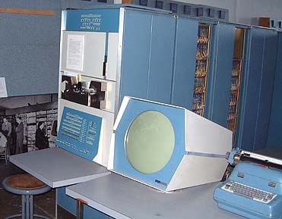
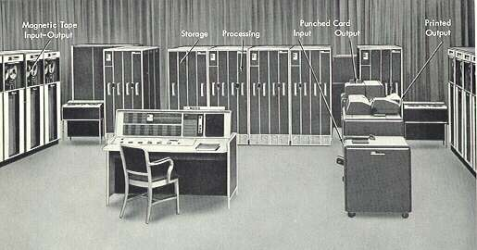
1960 – First commercial transistorized computers
DEC introduced the PDP-1and IBM released the 7090 which was the fastest in the world.

Slide 35
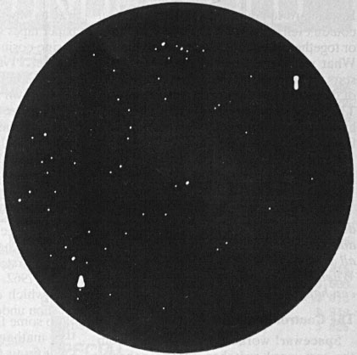
1962 – First computer game & word processor
Steve Russell at MIT invents Spacewar, the first computer game running on a DEC PDP-1.
Because the PDP-1 had a typewriter interface, editors like TECO (Text Editor and Corrector) were written for it.
Steve Piner and L. Peter Deutsch produced the first “word processor” called Expensive Typewriter (MIT's PDP-1 cost $100,000).

Slide 36
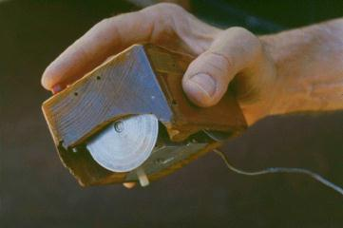
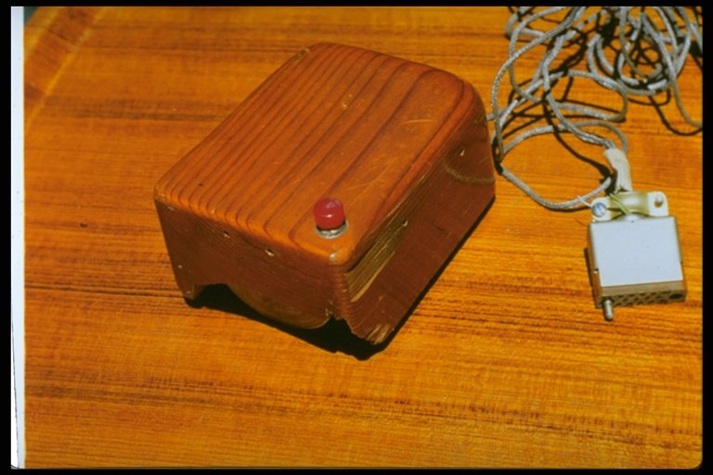
1964 – The mouse and window concept
Douglas Engelbart demonstrates the worlds first “mouse”, nicknamed after the “tail”.
SRI (Stanford Research Institute) received a patent on the mouse in 1970, and licensed it to apple for $40,000.

Slide 37
1969 - ARPANET
The precursor to the Internet as we know it, funded by ARPA (Advanced Research Projects Agency now DARPA) begins.
The first four nodes were located at:
UCLA
Stanford Research Institute
UC Santa Barbara
University of Utah

Slide 38
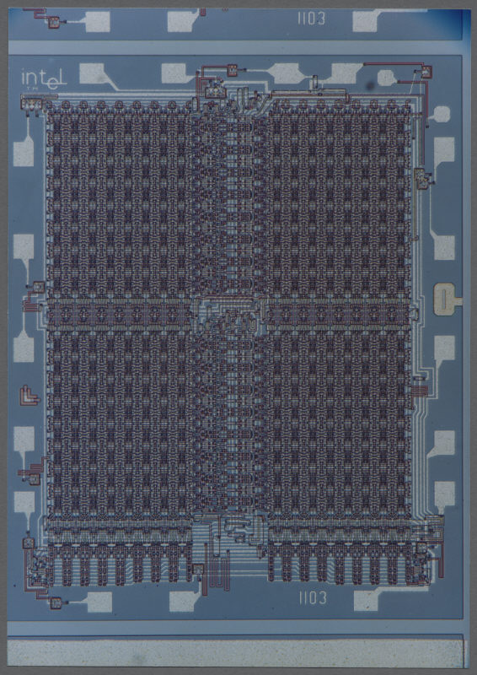
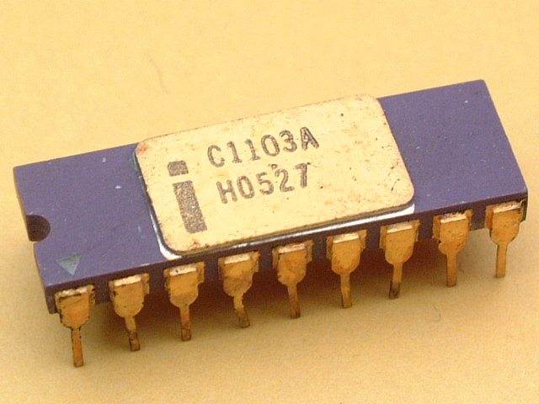
1970 – Intel 1103 Dynamic Memory Chip
Worlds first commercially available dynamic memory chip, 1024 bytes or 1KB

Slide 39
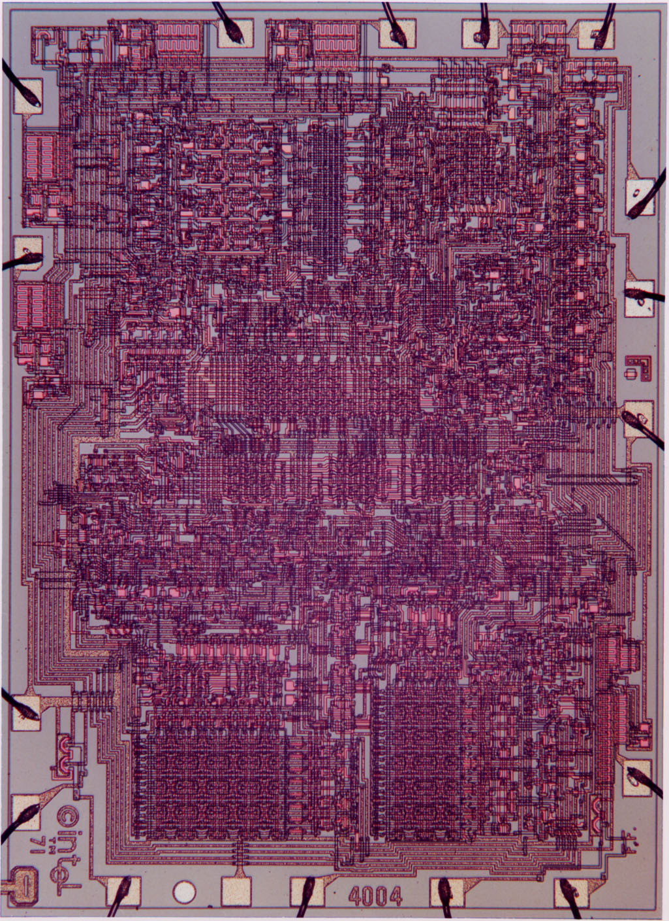
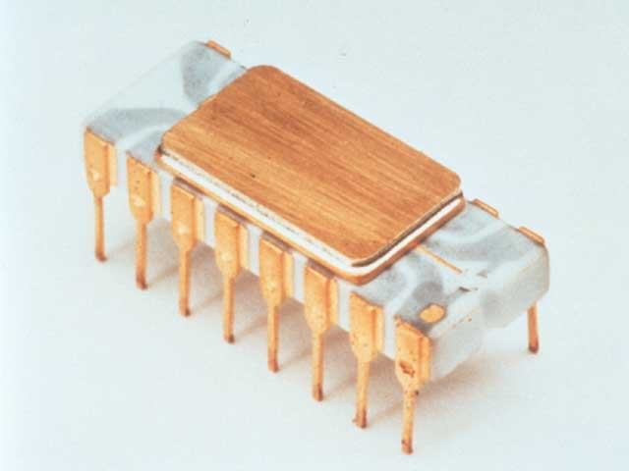
1971 – Intel 4004 Microprocessor
Worlds first microprocessor with 2,300 transistors, had the same processing power as the 3,000 cubic-foot ENIAC.

Slide 40
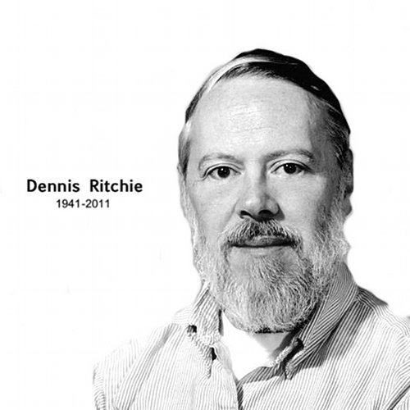
C Programming Language
C was originally developed at Bell Labs by Dennis Ritchie between 1972 and 1973 to make utilities running on Unix.
Notes:
C programming language was developed by Dennis Ritchie at dell Labs to make utilities run on Unix.
It became popular later in 1980’s

Slide 41
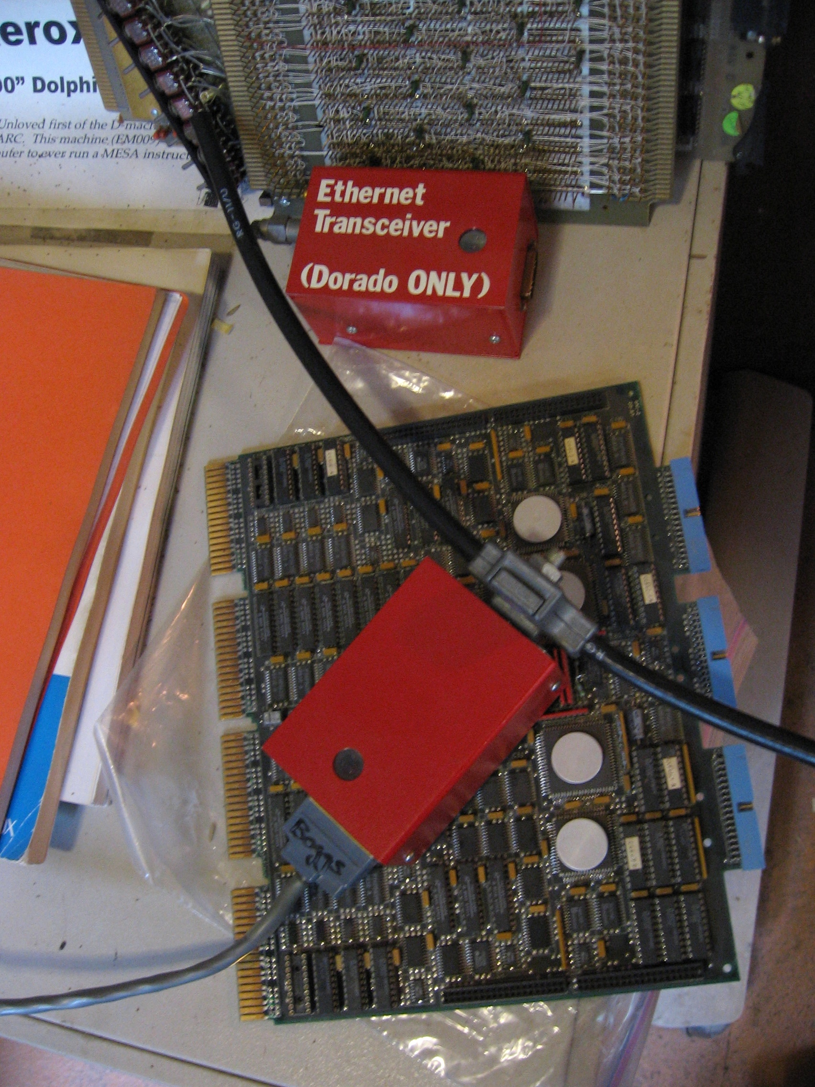
1973-1976 – Ethernet
Robert Metcalfe at Xerox invents Ethernet so that multiple computers can talk to a new laser printer. Originally, Ethernet used a large coaxial cable and ran at 3Mbit/sec.
Ethernet today runs over twisted pair (usually CAT5, or CAT6) and can achieve speeds of 10Megabit/sec to 1Gigabit (1000 Mbit/sec).

Slide 42
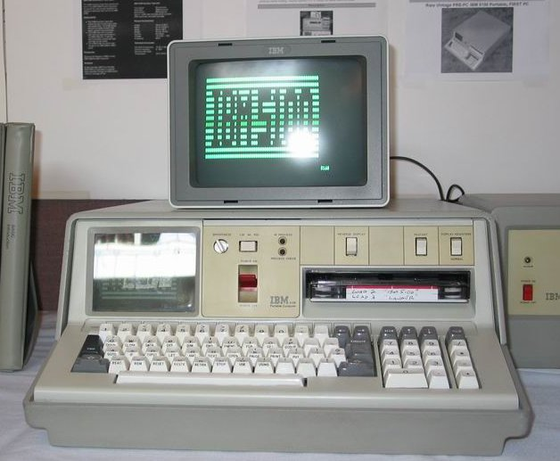
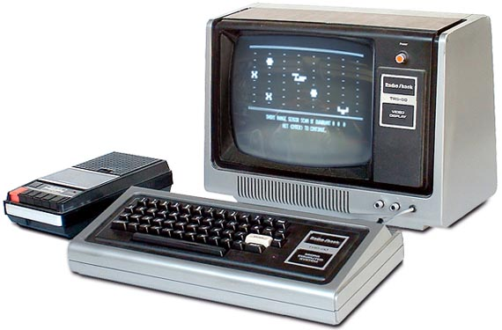
1974/1975 – Personal Computers
Scelbi Mark-8 Altair and IBM 5100 computers are first marketed to individuals (as opposed to corporations). They are followed by the Apple I,II, TRS-80, and Commodore Pet computers by 1977.

Slide 43
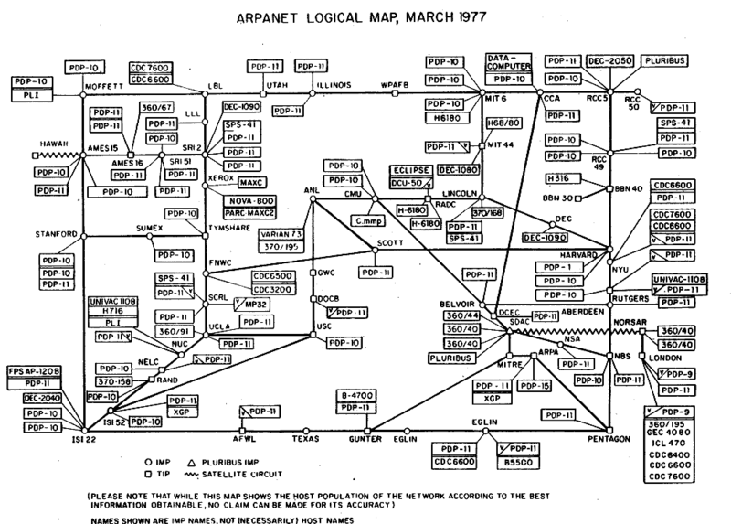
1977 – Growth of the ARPAnet

Slide 44
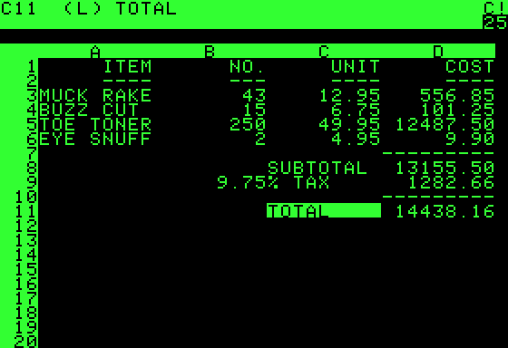
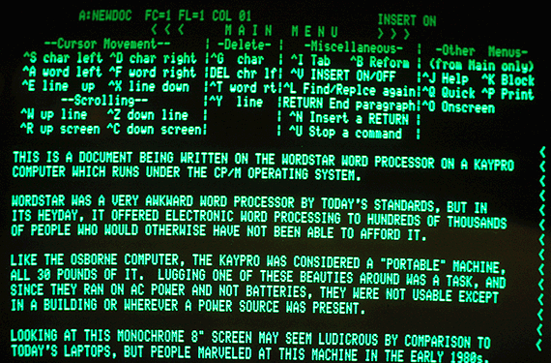
1978/1979 – First individual productivity software
VisiCalc Spreadsheet software and WordStar word processor are the “killer applications” for personal computers, especially for small business owners.

Slide 45
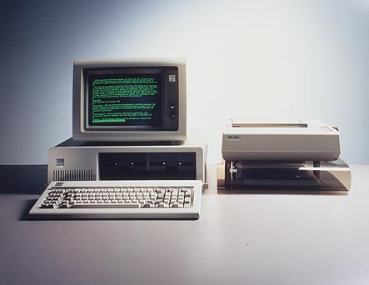
1981 – IBM PC
The IBM PC is introduced running the Microsoft Disk Operating System (MS-DOS) along with CP/M-86. The IBM PC's open architecture made it the de-facto standard platform, and it was eventually replaced by inexpensive clones.
CPU: Intel 8088 @ 4.77 MHz
RAM: 16 kB ~ 640 kB
Price: $5,000 - $20,000

Slide 46
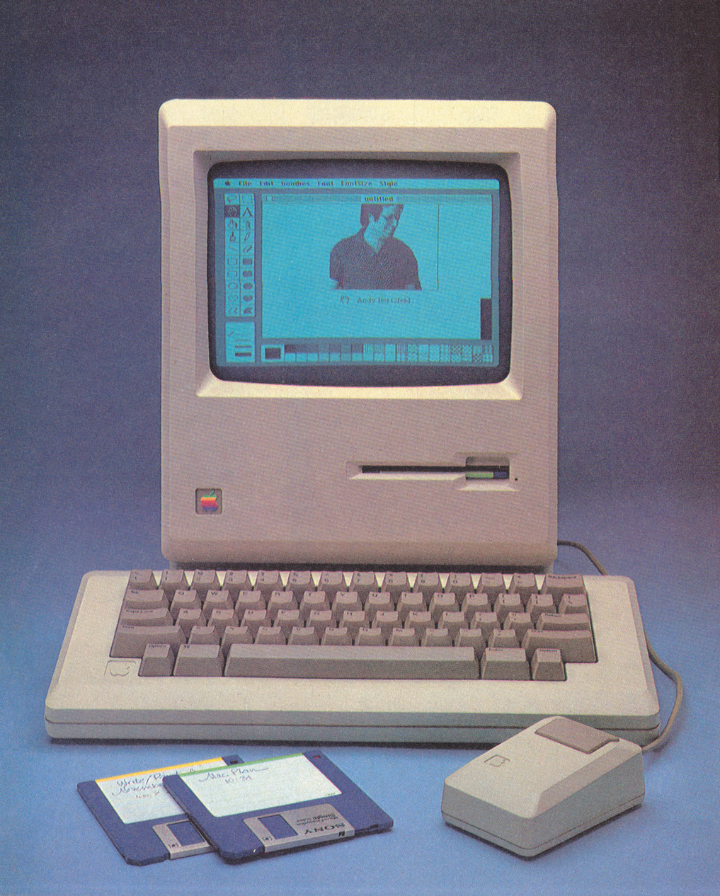
1984 – Apple Macintosh
Apple introduces the first successful consumer computer with a WIMP user interface (Windows Icons Mouse & Pointer), modelled after the unsuccessful Xerox Alto computer.
Motorola 68000 @8Mhz
128KB Ram
US$1,995 to US$2,495

Slide 47
C++ Programming Language
The first version on C++ was released in 1985
C++ is a general-purpose programming language created by Bjarne Stroustrup as an extension of the C programming language, or "C with Classes".
The language has expanded significantly over time, and modern C++ has object-oriented, generic, and functional features in addition to facilities for low-level memory manipulation.

